Slide 1
John Gower as Protest Poet
Kara L. McShane, Ursinus College (@karalmcshane)
ICMS 2019

Slide 2
Gower? Protest?
The power and problem of expectations – on both sides
Reform and politics of the day
Gower as a means to think about power: political authority, institutional corruption, common voice
A combination of shared and incredibly distinct concerns

Slide 3
The Assignment
Description: As part of your work for this course, you will record yourself reading a selection of Middle English from a poem to be determined by the class as a whole. We will then stitch these together to create one full recording of a work of Middle English literature, which I will make available at least to members of the course. (I am hopeful that we will be able to post it online for other learners of Middle English.)
I will assign & distribute passages once we have selected the work we’ll read. The amount of text you are responsible for will, of course, depend on the length of the work! Note: I would eagerly support members of the class who want to read aloud and discuss their experience doing so at COSA this semester.
Recording: 60%
Your recording will be graded along all the same requirements as your other recitations (consonants, vowels, rhyme/final e, fluidity, etc.) However, you will also be assessed on your interpretation of your passage – do you effectively convey a sense of the poem’s tone? Does the reading sound polished/practiced?
Reflection: 40%
Your reflection is an opportunity for you to consider how far your reading has come but also how your performances influence your understanding of the work. Accordingly, you should address the following questions:
  What did you discover about your passage through reading it aloud that you might not have noticed before?
  What decisions did you have to make about rhyme, meter, & tone to read your passage effectively?
  What did you find challenging, exciting, or interesting about preparing your passage?
Reflections should be 2-3 pages in length.

Slide 4
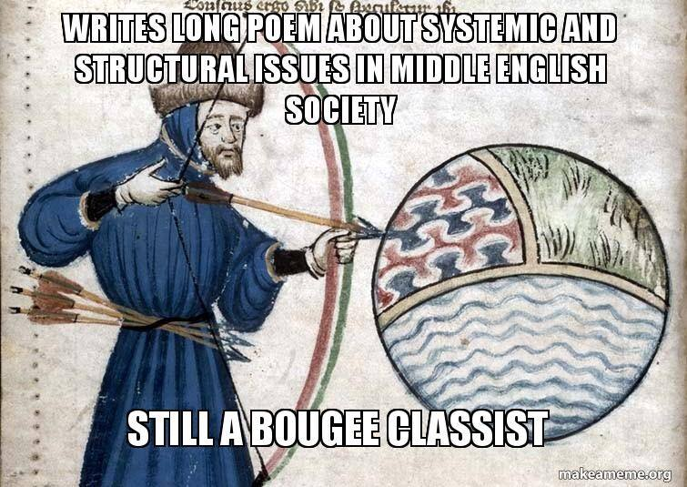
Student Engagement

Slide 5
Scaffolding
Four Translation Quizzes as part of Middle English learning
Three recitations and a “rough draft” of assigned lines (handed in digitally to resolve technical issues)
Grading criteria for readings:
  Consonants pronounced as appropriate
  Vowels pronounced as appropriate (distinction between long and short clear)
  Rhyme preserved
  Fluidity of reading
Two voluntary public readings for practice

Slide 6
The Final Product
Available at https://digitalcommons.ursinus.edu/english_mereadings/1/
Student Comments:
“Needless to say, I began this recording extremely frustrated. It was not until after our friend from London spoke about the necessity of vocal expression (and methods of such) in elevating a reading that I realized what my lines were missing. As I sat there smiling and reciting in front of the class as if talking to a child, I realized ‘hey….this could actually be pretty fun.’”
“I learned more about the history of our language and saw quite a few parallels between its archaic equivalent and the modern iteration. It was fascinating to see how words had changed, and where the meanings of many of our modern-day words come from. I think it was these discoveries that spurred me on and made me want to know more about pronouncing the language correctly, since that made it much easier to glean rhythm and meaning from the poet’s words.”
“When I went home to work one weekend at the host stand, I brought my Gower with me, practicing my passage during a slow lunch shift. Because of the lack of customers, the servers would walk in and catch a few words before their faces voiced their confusion. After explaining the course and what I was doing, I’d read the section to them, which went right over their heads, but they were still impressed.”
The process of recording has been extremely informative in my knowledge of medieval sentence structure, rhythm, meter, and vowel pronunciations. I found before that this project began I was trudging through dense reams of poetry that made no semblance of sense in my head. Reading out loud began as an embarrassing struggle that I partook alone in my room on weekend mornings, but slowly, with the help of the sunshine, [a classmate], and the visiting actor, I began coming out of my shell and into the language.
“However, speaking aloud eventually aided the process of learning the text: with more practice reading and repeating the lines in Middle English, I was able to gain a better sense of what the poem was trying to convey.”
“While reading it aloud, it was easier to tell the rhyme scheme and even the meanings of certain words that look a bit weird on paper. Because of this, I was able to appreciate the style of writing more.”

